Slide 1
Toronto Housing Market
VAIDEHI ATODARIA

Slide 2
OUTLINE
DESCRIPTION OF PROBLEM
DATA SOURCE
TECHNOLOGIES USED
PREPROCESSING OF DATA
VISULIZATIONS
CONCLUSION AND FUTURE WORK

Slide 3
Description Of Problems
Housing Affordability and availability is a major issue in Toronto, as well as many other cities around the world. In recent years, the city has seen rapid growth in real estate prices, making it increasingly difficult for many residents to find affordable housing.
This project aims to visualize the trends and patterns in the Toronto housing market over the past decade, with the goal of providing insights and understanding to stakeholders and the general public.
Research Question
How has Average price of homes changed over time in Toronto?
Are there any patterns or trends in the housing market that can be observed over time?
How do different neighborhoods in Toronto compare in terms of housing prices and trends?
Are there any factors that are driving changes in the Toronto housing market, such as changes in the economy, population growth, or policy changes?
How has the pandemic affected the Toronto housing market, and what
are the long-term implications?

Slide 4
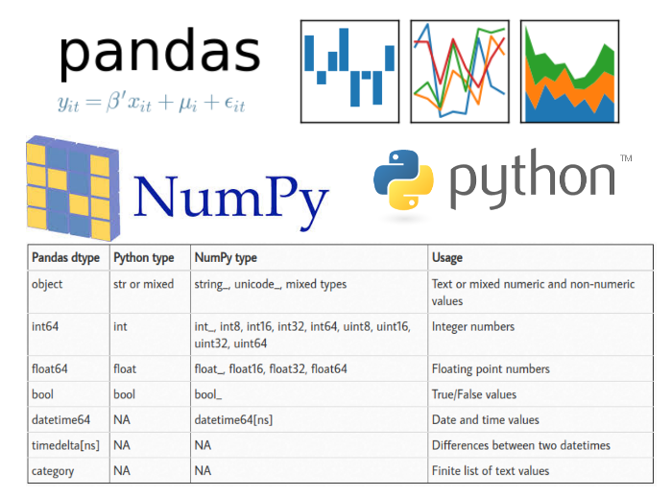
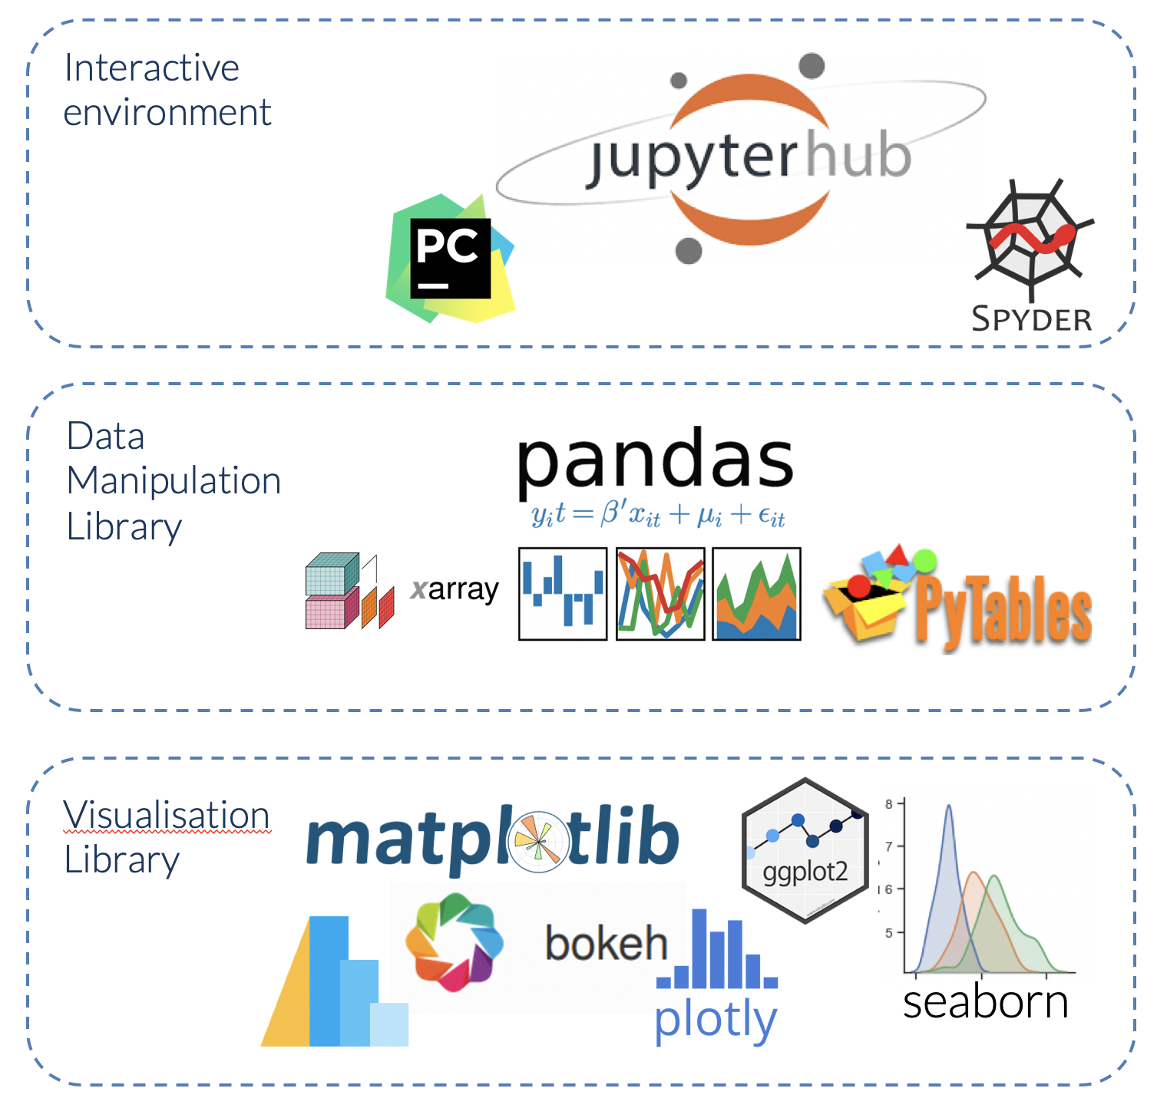
DATA SOURCE
The Toronto Home Price Index data set from Kaggle (https://www.Kaggle.com/datasets/alankmwong/toronto-home-price-index will be used for this project. This data set includes monthly home price indices for the city of Toronto, broken down by neighborhood and dwelling type, from January 2005 to August 2021.
TOOLS USED

Slide 5
PROCESSING OF DATA
Clean and preprocess the data, such as handling missing values converting data types.
DATASETS INFORMATION
LOCATION:NEIGHBOURHOOD IN GRATER TORONTO
Comp - stands for composite and takes into account the various types of housing into a single value.
SFDetach - stands for Single Family Detached Home, or commonly referred to as houses SFAttach - stands for Single Family Attached Home THouse - stands for Townhouses Apart - is the abbreviation for Apartments or Condominiums

Slide 6
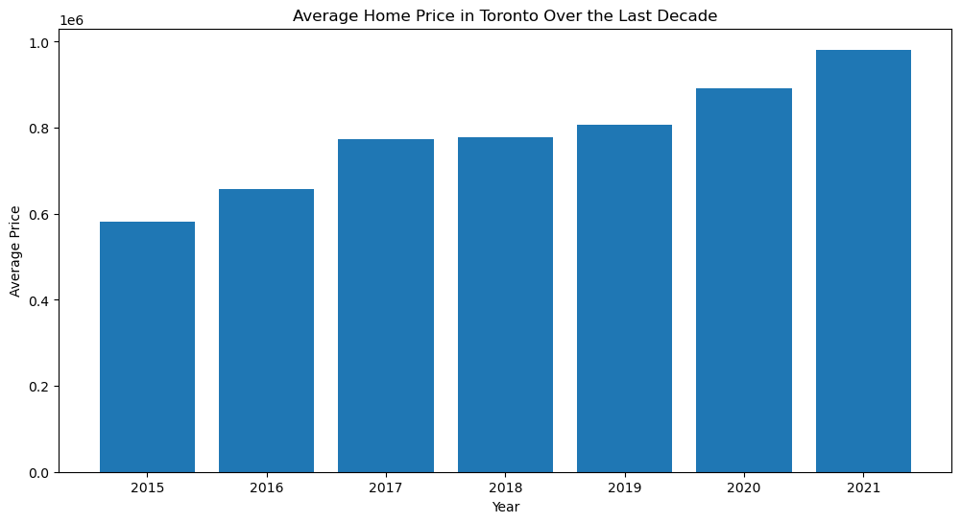
Average Home Price in Toronto over the Decade.

Slide 7
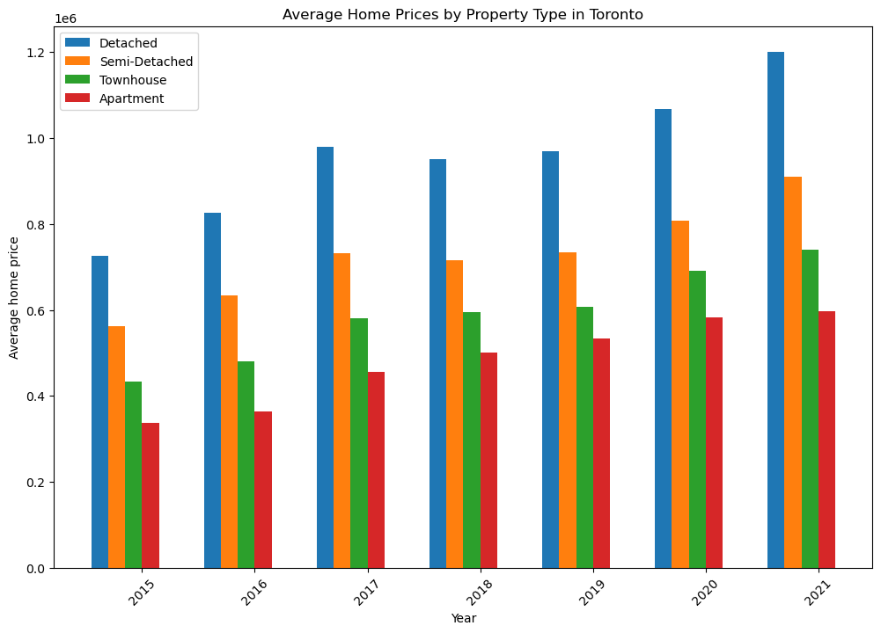
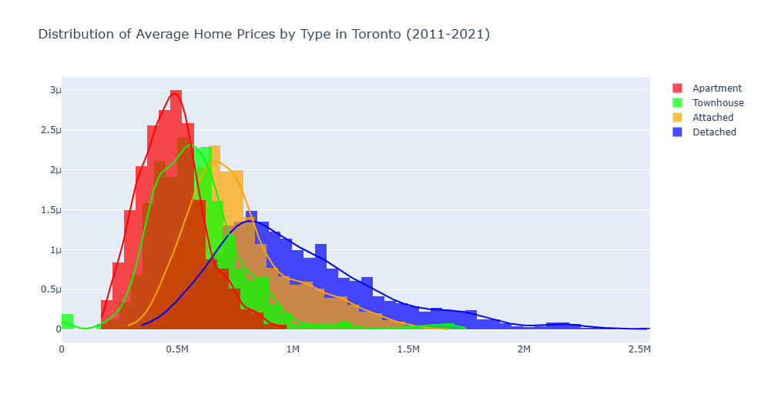
Average price by property type comparison
The increase in average home prices from 2019 to 2021 suggests that the housing market in Toronto has experienced growth during this period. This could be attributed to factors such as low interest rates, increased demand for housing, population growth, or economic expansion.

Slide 8
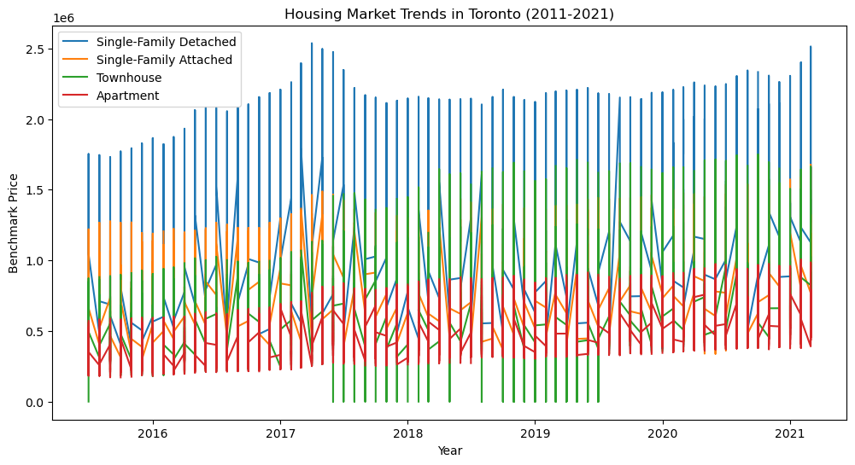
Trends in housing market
Single-Family Detached:
Highest Price: 2536900.0
Date: 2017-04-01 00:00:00
Single-Family Attached:
Highest Price: 1677200.0
Date: 2021-03-01 00:00:00
Townhouse:
Highest Price: 1750500.0
Date: 2020-10-01 00:00:00
Apartment:
Highest Price: 1005500.0
Date: 2021-02-01 00:00:00

Slide 9
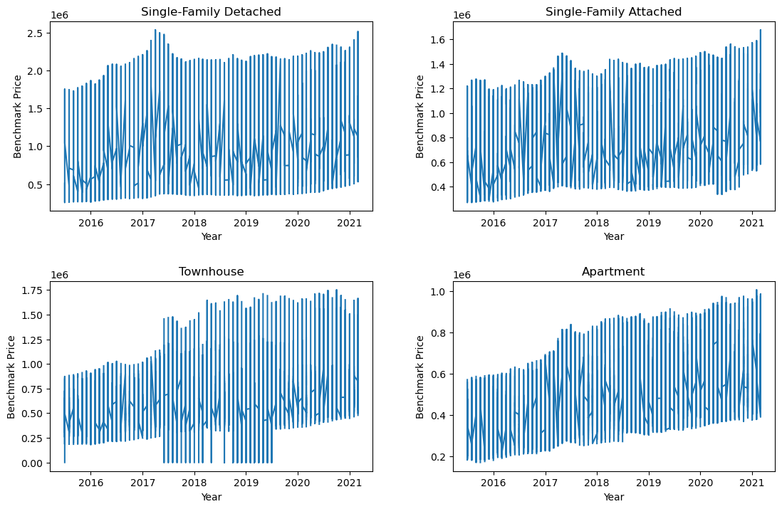
Prices by Different property types
Lowest Prices:
Single-Family Detached:
Lowest Price: 259100.0
Date: 2015-07-01
Single-Family Attached:
Lowest Price: 273300.0
Date: 2015-07-01
Townhouse:
Lowest Price: 0.1
Date: 2018-08-01
Apartment:
Lowest Price: 171400.
Date: 2015-10-01

Slide 10
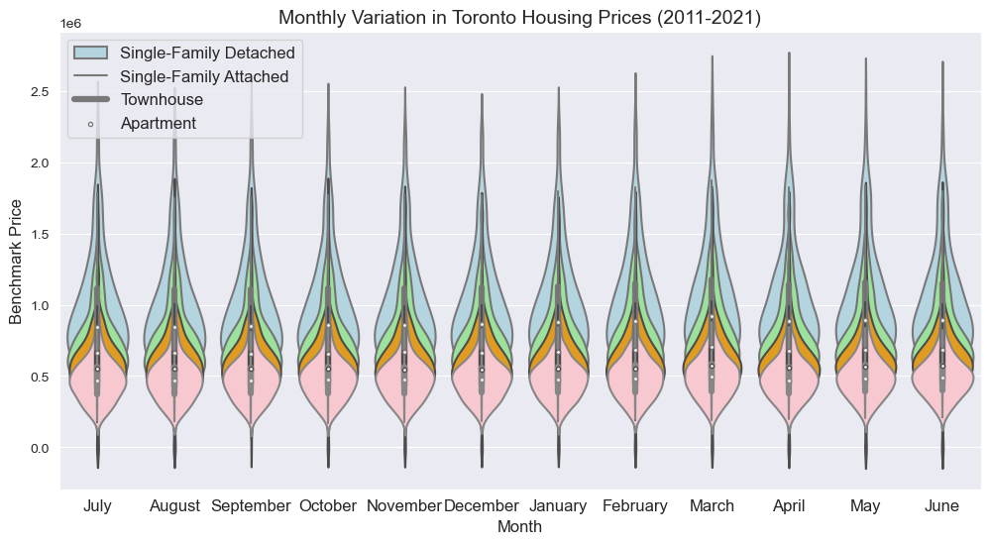
Seasonal variation

Slide 11
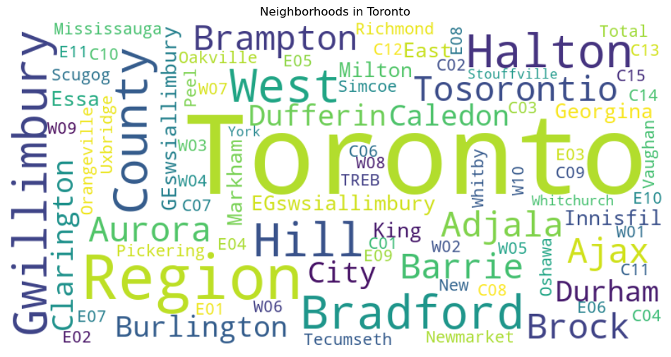
Different Popular Neighbourhood in Toronto by World Cloud

Slide 12
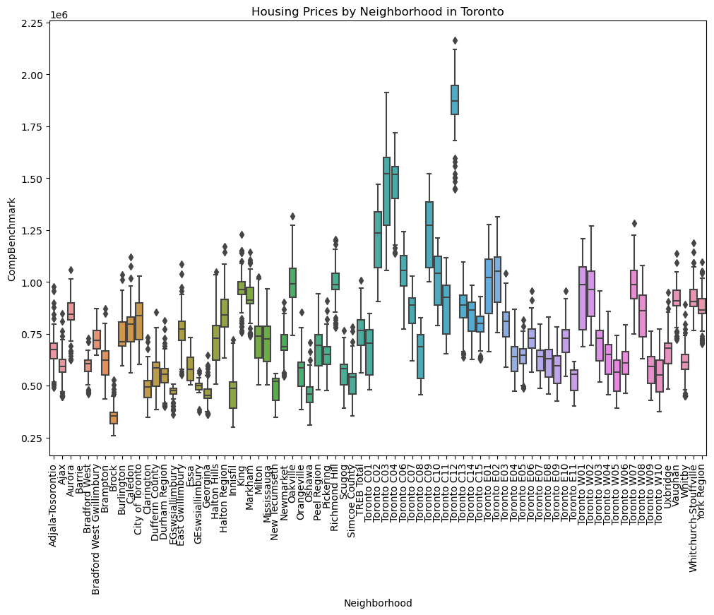
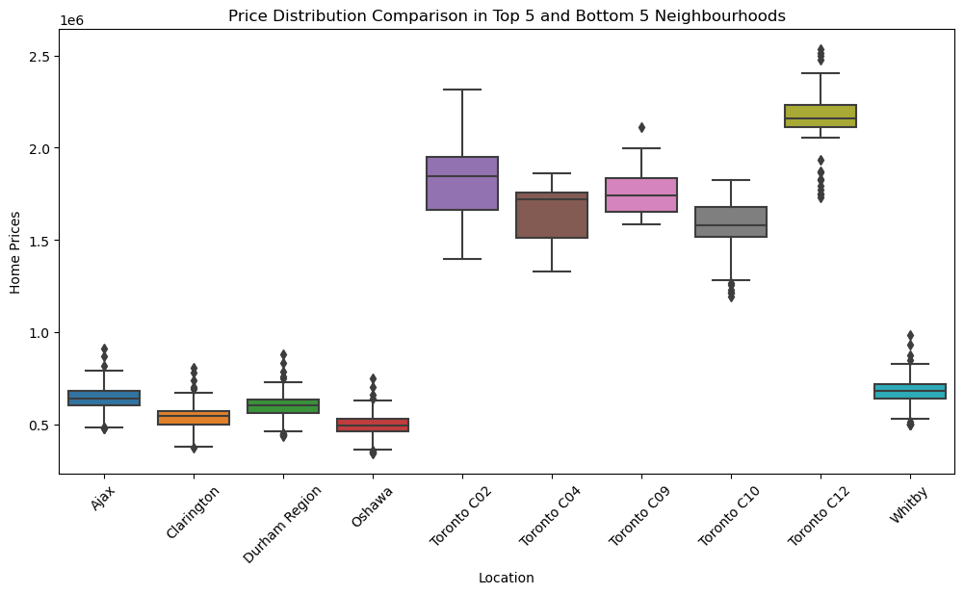
Different Neighbourhood Trends in Toronto

Slide 13
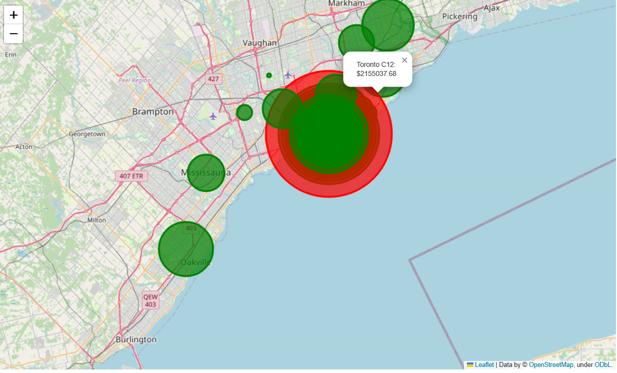
Map with highlighted popular neighborhoods of downtown

Slide 14
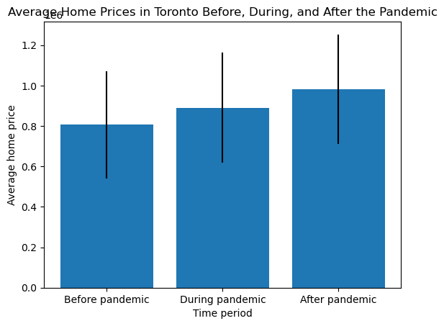
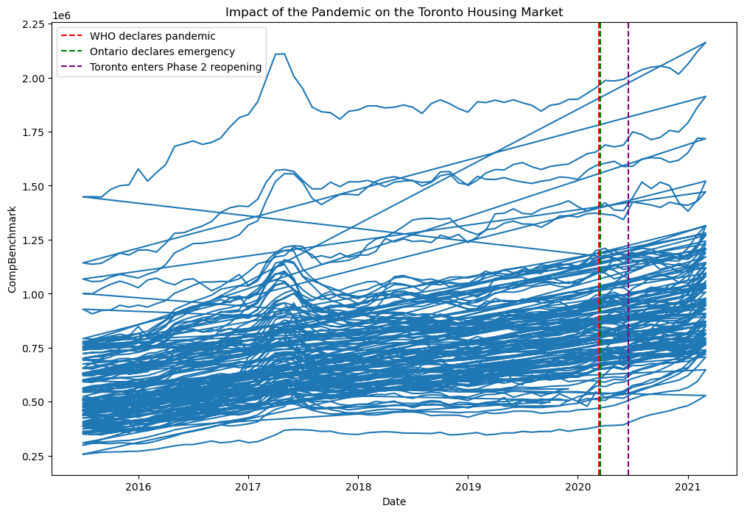
Pandemic affected the Toronto housing market

Slide 15
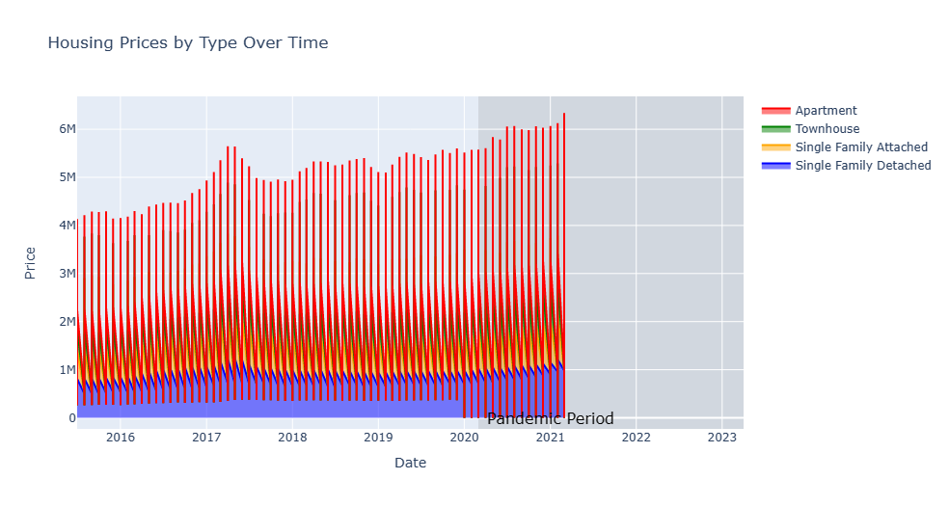
Property's prices during pandemic

Slide 16
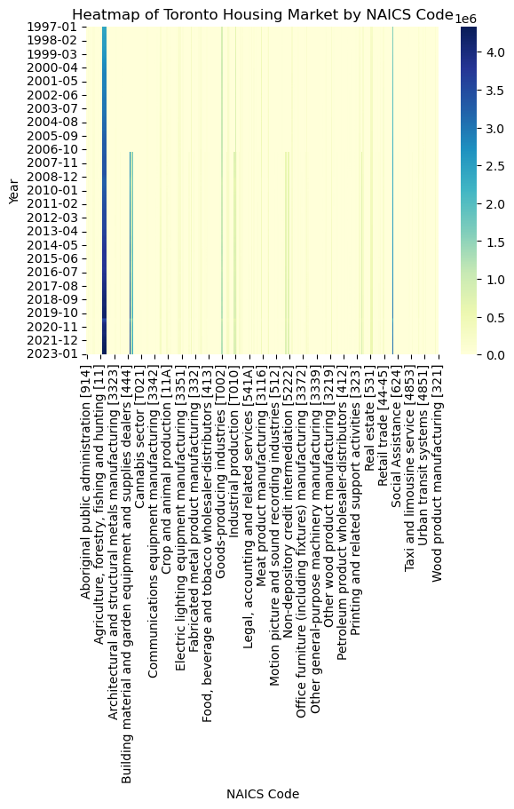
factors that are driving changes in the Toronto housing market

Slide 17
CONCLUSION AND FUTUREWORK
The market has also experienced periods of instability and uncertainty, such as during the 2008 financial crisis and the current COVID-19 pandemic. These events have had a significant impact on the Toronto housing market, causing fluctuations in prices and demand.
Based on the analysis of the Toronto housing market,it can be concluded that the average price of a home in Toronto has increased significantly over the past decade based on the clear patterns and trends of housing market.There are factors such as changes in the economy,population growth,and policy changes have played a significant role in driving changes in the Toronto housing market.
Future Work
Toronto market is complex and multifaceted,and there is still much to be learned and understood about it patterns and trends.By continuing to analyze and study the market,we can better understand its dynamics and make more informed decisions about future of housing in Toronto.

Slide 18


